Slide 1

DEPARTMENT OF
ARTIFICIAL INTELLIGENCE AND DATA SCIENCE
ACADEMIC YEAR 2025 - 2026
SEMESTER III
ARTIFICIAL INTELLIGENCE LABORATORY
MINI PROJECT REVIEW
Sudoku Solver as a CSP framed like a game
REGISTER NUMBER | 2117240070366
NAME | Yamunadevi Prakash
YEAR | II
SECTION | F
FACULTY IN-CHARGE | Mrs. M. Divya

Slide 2
PROBLEM STATEMENT
To design and implement a Sudoku Solver in Python that models the puzzle as a Constraint Satisfaction Problem (CSP) and solves it efficiently using backtracking search combined with constraint propagation and Minimum Remaining Value (MRV) heuristic, while providing a simple interactive game-like interface.

Slide 3
THEORETICAL BACKGROUND
A Constraint Satisfaction Problem (CSP) consists of:
Variables: Each cell in the Sudoku grid (81 in total).
Domains: Possible values {1,2,3,4,5,6,7,8,9}.
Constraints: Each number must appear once per row, column, and subgrid.
Algorithm Overview
Backtracking Search:
A depth-first search method that assigns values to variables one by one. If a violation occurs, it backtracks to try alternate assignments.
Constraint Propagation:
The domains of unassigned variables are reduced dynamically after each assignment, ensuring that no future assignments violate constraints.
MRV Heuristic (Minimum Remaining Values):
Chooses the variable with the smallest domain first, thereby reducing branching and improving efficiency.

Slide 4
THEORETICAL BACKGROUND
Literature Survey
Russell & Norvig, Artificial Intelligence: A Modern Approach, emphasize CSPs for structured logical problem solving.
Dechter (2003) in Constraint Processing highlights efficiency improvements from heuristics like MRV and forward checking.
Other methods (e.g., genetic algorithms, simulated annealing) exist but CSPs remain the most interpretable and consistent for Sudoku.
Justification for Choosing CSP
Sudoku fits naturally as a CSP because all constraints are explicit and deterministic. CSP solvers handle such structured constraints more efficiently than heuristic search or brute force methods.

Slide 5
IMPLEMENTATION AND CODE
Link to code in Git-hub Repository
List | Git-hub Repository Links
Implementation of Code Link | https://github.com/YamunadeviPrakash/Sudoku-Solver/main.py.git
Word Document Report Link | https://github.com/YamunadeviPrakash/Sudoku-Solver/ai-report-yamuna.git
PPT Link | https://github.com/YamunadeviPrakash/Sudoku-Solver/ai-ppt.git

Slide 6
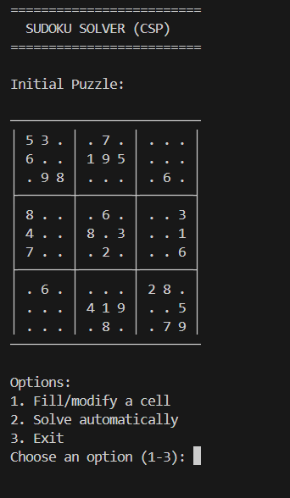
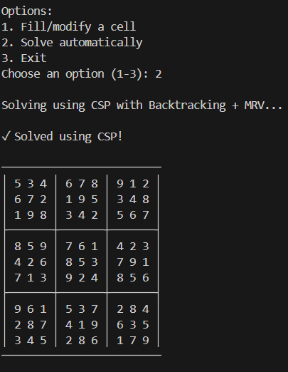
OUTPUT AND RESULTS

Slide 7
OUTPUT AND RESULTS
The CSP-based approach successfully solves Sudoku puzzles with efficiency and clarity. The MRV heuristic and constraint propagation reduce backtracking and make the algorithm intelligent and systematic.
Future Enhancements:
Add graphical user interface (GUI) using Tkinter.
Implement forward checking for deeper propagation.
Add random Sudoku puzzle generation and difficulty levels.
Integrate timing and performance statistics for educational insight.

Slide 8
REFERENCES
Russell, S. J., & Norvig, P. (2020). Artificial Intelligence: A Modern Approach (4th Ed.). Pearson.
Dechter, R. (2003). Constraint Processing. Morgan Kaufmann.
Apt, K. R. (2003). Principles of Constraint Programming. Cambridge University Press.
Towards Data Science Blog – “Solving Sudoku with CSP and Backtracking in Python.”
GeeksforGeeks – “Sudoku Solver using Backtracking Algorithm.”

